Slide 1
MULTIDIMENSIONAL DATA MODEL

Slide 4
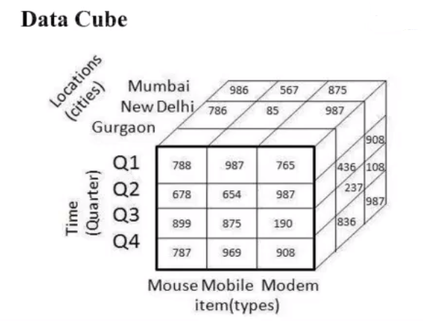

Slide 9
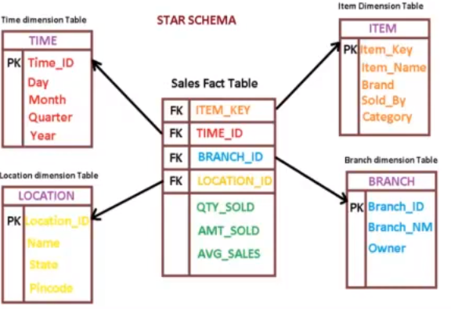

Slide 11
